Slide 1
2018 Popcorn Campaign
Guardians of the Treasure

Slide 2
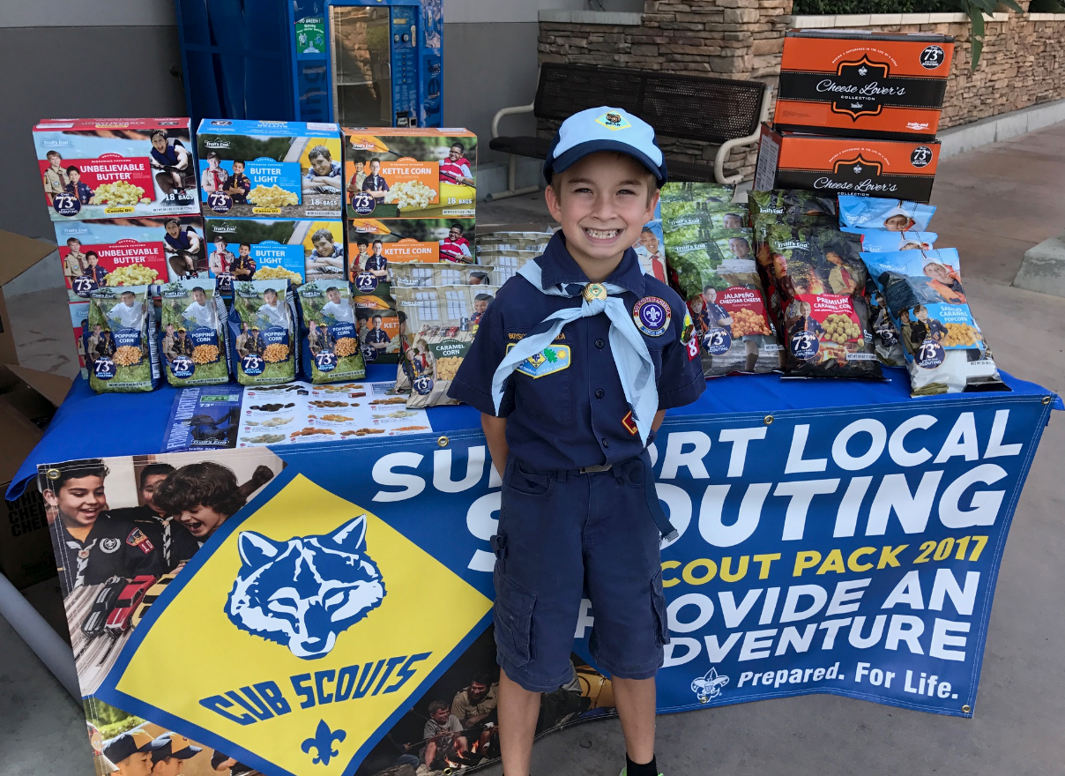
IT’S FOR THE SCOUTS
2017 Unit Commissions $125,695
Scouts fundraise to earn their own way in Scouting. Provides them the opportunity to fund their entire year in Scouting.
Provides Units the funding needed to execute a successful program year.
2018 POPCORN FUNDRAISER
Notes:
Fill in your council’s commission that was paid out. Stress the importance of monies earned

Slide 3
WHY WE SELL POPCORN
2018 POPCORN FUNDRAISER
Notes:
Introduce Pack 2017 video on why we sell.
https://www.trails-end.com/unit-training-dashboard

Slide 4
SET YOUR GOAL
YOUR UNIT GOAL SHOULD BE BASED ON EVERY SCOUT EARNING THEIR IDEAL YEAR OF SCOUTING.
Q: What is the Ideal Year of Scouting?
A: It’s your Unit’s calendar of Adventures and Events, such as Campouts, Day Trips, Blue & Gold, Pinewood Derby, and more!
Provide your Scouts with the experience of a lifetime.
2018 POPCORN FUNDRAISER
Notes:
Push the Ideal Year of Scouting. We want to express the id

Slide 5
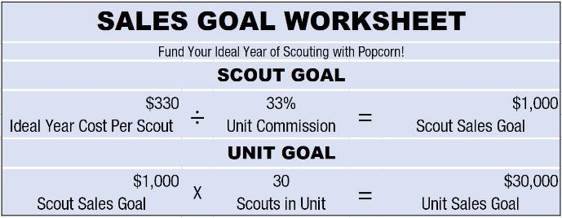
SET YOUR GOAL
What is your Ideal Year of Scouting?
Popcorn fundraising goals should be based on your budget to fund your unit’s Program Plan with one fundraiser.
How much popcorn will each Scout sell to earn their way?
2018 POPCORN FUNDRAISER
Notes:
Whatever their goal is, they can hit it. Remind them of what Pack 2017 did. It is the extreme but whatever you want to do is good

Slide 6
SCOUT GOAL OF $1,000
Your Scouts should sell $1,000 and earn an entire year of fun filled Scouting programs with only three easy steps:
Scouts work four 2-hour solo Show n Sell shifts. Scouts average $100/hr. | $800
Scouts sell door-to-door to their neighbors for about an hour. | $100
Scouts record online orders from family and friends, where on average, Scouts recorded $165 in 2017! | $165
Goal Achieved | $1,065
2018 POPCORN FUNDRAISER
Notes:
Show how easy it is to hit $1,000 in 8 hours or less as in this example

Slide 7
UNIT GOAL OF $30,000
A Unit with 30 Scouts should sell $30,000 in Popcorn.
Book two stores for Show n Sells Friday’s, Saturday’s, and Sunday’s throughout your sale. This will provide more shifts than you need, allowing some Scouts to be Top Sellers!
Scouts each sell door-to-door to their neighbors for about an hour. Tip: Scouts that have popcorn with them (Show & Deliver, or “Wagon sales”) sell more popcorn in less time!
Scouts sell to friends and family online. The average online sale is over $65! It only takes two sales per Scout to make a big difference in your sale. There’s new online incentives too!
2018 POPCORN FUNDRAISER
Notes:
This expands the Scout goal to the Unit level. Expect objections! Even finish the slide with “I know $30,000 sounds like a lot, but this wasn’t our idea. Pack 2017 gave us their system, and we’re going to share that with you.”

Slide 8
HOW THEY DID IT
2018 POPCORN FUNDRAISER
Notes:
https://www.youtube.com/watch?v=uZW-igKzX7M

Slide 9
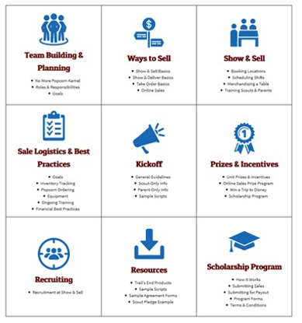
TRAINING VIDEOS
POPCORN TEAM TRAINING
Videos at Trails-End.com
Developed by Team that sold $190,000
Focused on Show n Sell/Show n Deliver
No login required-watch anytime
24 VIDEOS (40 MINUTES)
Team Building & Planning
Ways to sell
Show n Sell basics
Booking locations
Scheduling shifts
Merchandising a table
Training Scouts & Parents
Show n Deliver basics
Kick-offs
Logistics of the sale
Financial best practices
And much more on Trails-End.com
www.Trails-End.com/training
2018 POPCORN FUNDRAISER
Notes:
Stress all the videos we have available on Trails-End.com

Slide 10
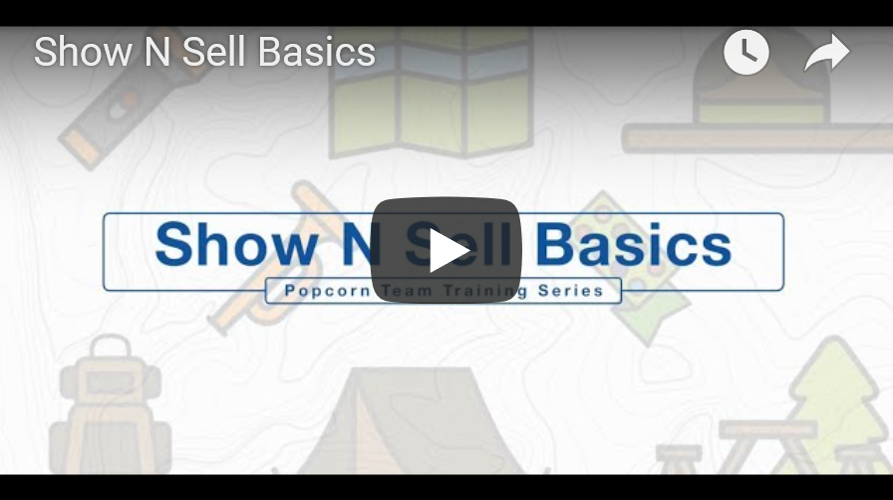
SHOW N SELL BASICS
2018 POPCORN FUNDRAISER
Notes:
Embed / Play the “Show & Sell” basics video Reinforce the Show & Sell plan Remind them “each video goes into details on various aspects of the sale”
https://www.trails-end.com/show-and-sell

Slide 11
Show N Sell Scheduling
Online sales monitoring / scheduling program
https://signup.com/
https://www.signupgenius.com/
www.Trails-End.com/training
2018 POPCORN FUNDRAISER
Notes:
Stress all the videos we have available on Trails-End.com

Slide 12
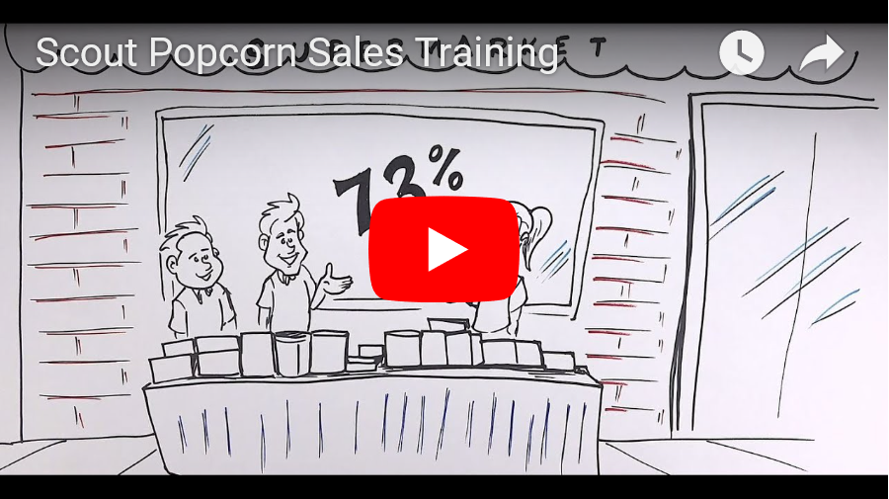
SCOUT POPCORN TRAINING
2018 POPCORN FUNDRAISER
Notes:
https://www.trails-end.com/scout-training-dashboard

Slide 13
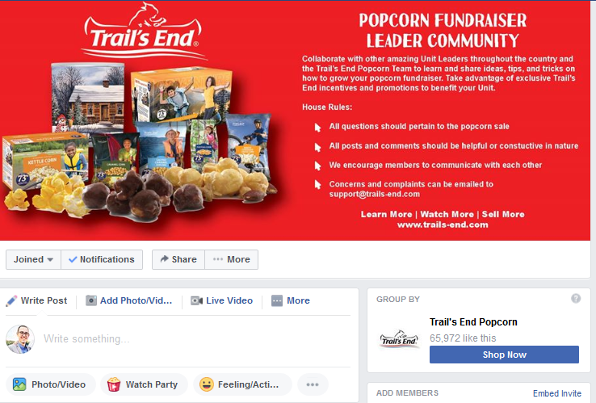
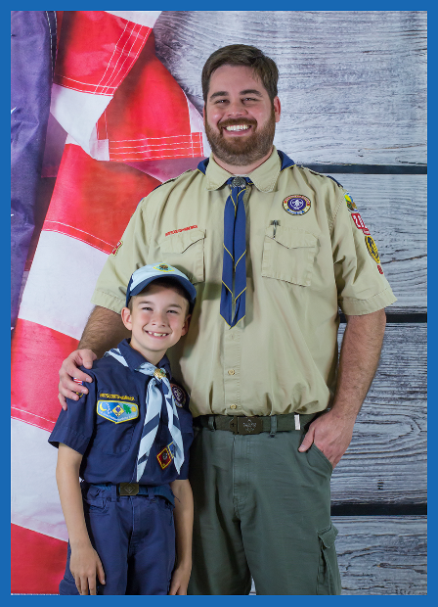
POPCORN COMMUNITY SUPPORT
FACEBOOK GROUP
Connect with other Kernel’s
Share ideas
Ask questions – get answers!
Weekly Webinars Available
https://www.facebook.com/groups/868382320032192/
PLANNING SESSION
The Team from Pack 2017 are committed to your Units success.
Get one on one help from the Pack 2017 Team. Setup a time now!
https://www.trails-end.com/pack2017
2018 POPCORN FUNDRAISER
Notes:
There are more tools available to you. We have a Facebook Group, and Sean from Pack 2017.

Slide 14
UNIT COMMISSION
BASE COMMISSION: 30%
TRAINING BONUS COMMISSION: 2%
ON TIME BONUS COMMISSION (Nov 30): 1%
CASH IN LEIU OF PRIZES: 3%
2018 POPCORN FUNDRAISER
Notes:
Review commission

Slide 15
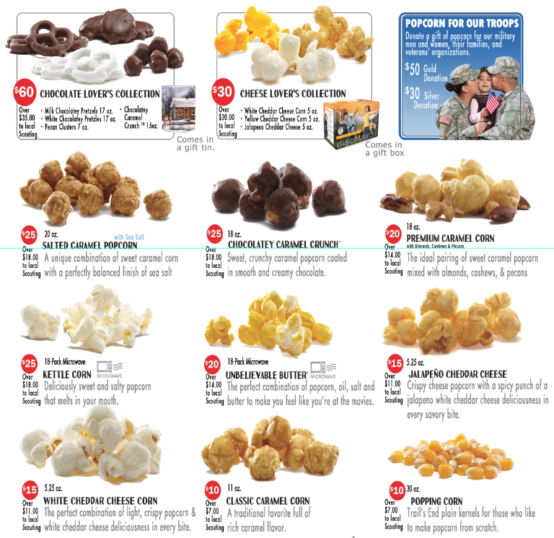
2018
PRODUCT
MIX
2018 POPCORN FUNDRAISER
Notes:
Insert product mix

Slide 16
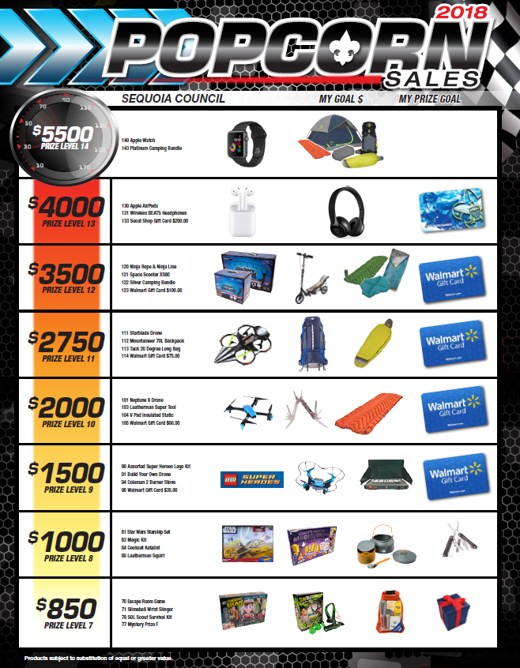
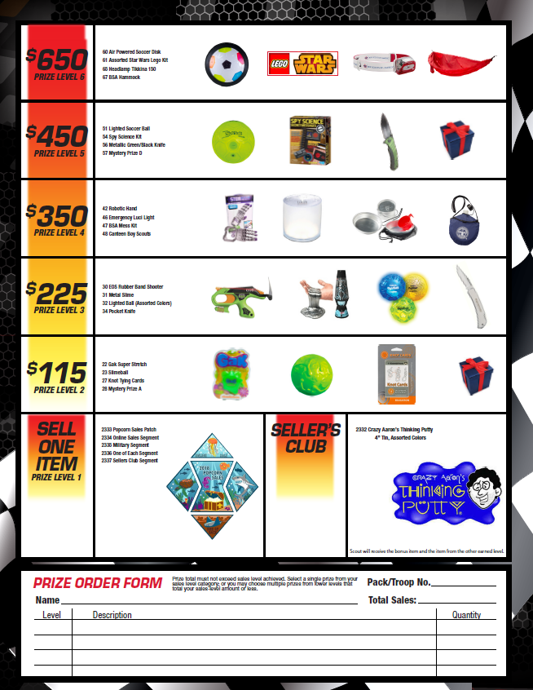
SCOUT INCENTIVES
2018 SCOUT INCENTIVES
2018 POPCORN FUNDRAISER
Notes:
Insert Prize flyer

Slide 17
SCOUT INCENTIVES
2018 SCOUT BONUS PRIZES
On top of either reward program your unit chooses, every unit that participates is also eligible for the following bonus prizes from Trail’s End.
* Participation Patch: Anyone who participates in the sale will receive a 2018 commemorative patch. You will need to order these items online even if you’re not using the BSA prize program.
* Participation Patch Rockers: Anyone can earn the four rockers offered this year. They are: Military Sale, Online Sales, One of Each and Sellers Club ($700+ in sales)
* Trail’s End Scholarship Program for $2500+ Sellers: The Trail’s End Scholarship Program has helped many Scouts pay for higher education. To participate you only have to sell a minimum of $2,500 during one season, and the benefits add on every year after that! Complete the “Scholarship Program” Form which can be found at trails-end.com/scholarship-program
* The Sellers Club”: Sell $700 worth of product by October 4th and earn a trip to the Mid-Sale Rally on Saturday, October 6th. Food, fun, games and prizes! Sellers Club members also receive a 4oz tin of Crazy Aarons Thinking Putty!
2018 POPCORN FUNDRAISER
Notes:
Update if applicable or delete if not needed.

Slide 18
ONLINE FUNDRAISING
JOIN THE THOUSANDS WHO’VE RAISED OVER
$12 MILLION FOR THEIR SCOUTING ADVENTURES
HOW IT WORKS
Step 1: Create Your Online Fundraising Page
It takes less than 10 minutes to register, personalize your Scout page, and start selling.
Step 2: Share with Family and Friends
Our built-in sharing capabilities via email, social, and text message make sharing easier than pitching a tent.
Step 3: Receive Support
Family and friends visit your fundraising page, where the average order value is $65, and place orders on your behalf.
Step 4: Track Your Online Fundraising Orders
See who’s supported your fundraiser, send them thank you emails, and request additional support.
Scouts can start their adventure by registering at Trails-End.com
2018 POPCORN FUNDRAISER

Slide 19
ONLINE FUNDRAISING
DISCOVER THE #1 ONLINE POPCORN FUNDRAISING PLATFORM FOR SCOUTS
BENEFITS
Reach friends & family outside of your community
Orders are 4 times greater than face-to-face sales
The average online order value is $65
The average sales per Scout is $165
Incentives for Scouts and Units
Products are delivered directly to the consumer
Scouts have the ability to fundraise year round
FEATURES:
Only takes 10 minutes for a Scout/parent to register and start selling
Personalized Scout webpage
Built-in sharing capabilities via email, social, and text message
Mobile friendly and easy to sell on the go
Scout and Unit sales leaderboard
Real-time sales reporting for Scouts and Unit Leaders
It’s easy and convenient to use
Safe and secure
2018 POPCORN FUNDRAISER

Slide 20
ONLINE INCENTIVES FROM TE
INCENTIVES FOR SCOUTS
Online Prize Program: Sell $300 online in a calendar year and earn 5% of every dollar sold as an Amazon.com Gift Card
Win a Trip to Walt Disney World® Resort: Eight Scouts that register an account on Trails-End.com and record online orders will have a chance to win a trip for two
Challenges: Scouts/parents should opt-in to receive email and text messages from Trail’s End to participate in challenges for a chance to win great prizes
INCENTIVES FOR UNIT LEADERS
$10 for 10: Units will earn a $10 Amazon.com Gift Card for every 10 Scouts that register an account and record at least one order
2018 POPCORN FUNDRAISER

Slide 21
TOP SELLER
WHAT IT TAKES TO BE A TOP SELLER
Scouts work ten 2-hour solo Show n Sell shifts. Scouts average $100/hr. | $2,000
Scouts sell door-to-door to their neighbors for about four hours. | $400
Scout records five to six online orders from family and friends, where the average order value was $65 in 2017! | $350
Goal Achieved | $2,750
2018 POPCORN FUNDRAISER
Notes:
Provide a Top Seller example. This is what you want all Scouts to strive for.

Slide 22
KEY DATES
KEY DATES TO REMEMBER
Show-n-Sell orders due: By Monday, August 20, 10PM
Show-n-Sell distribution: On Friday, September 7
Show-n-Sell returns: By/On Friday, October 19
Take Orders due: By Monday, October 22
Prizes due: By Friday, November 2
Take Order distribution: On Friday, November 9
Payment due to Council: By Friday, November 30
2018 POPCORN FUNDRAISER
Notes:
Update dates

Slide 23
THANK YOU
2018 POPCORN FUNDRAISER

Slide 24
APPENDIX
2018 POPCORN FUNDRAISER

Slide 25
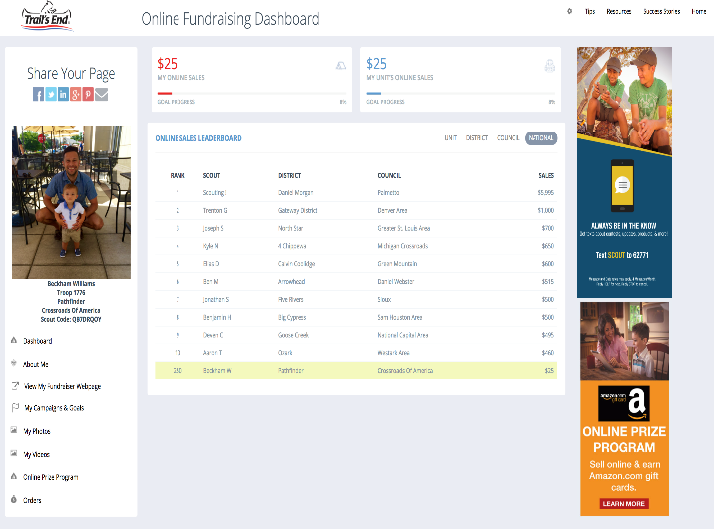
TRAILS-END.COM – SCOUT
SCOUT’S ACCT. DASHBOARD:
SHARE YOUR PAGE
SCOUT SALES LEADERBOARD
ONLINE SALES STATUS GRAPHS
ACCOUNT NAVIGATION
2018 POPCORN FUNDRAISER

Slide 26
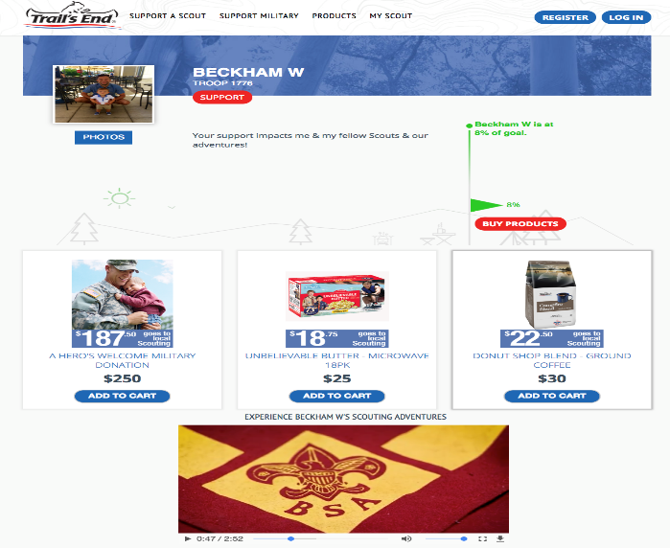
TRAILS-END.COM – SCOUT
SCOUT’S CONSUMER-FACING PAGE:
PROFILE PIC
SCOUTING STORY
GOAL PROGRESS
FAVORITE PRODUCT
SCOUTING VIDEO & PHOTOS
2018 POPCORN FUNDRAISER

Slide 27
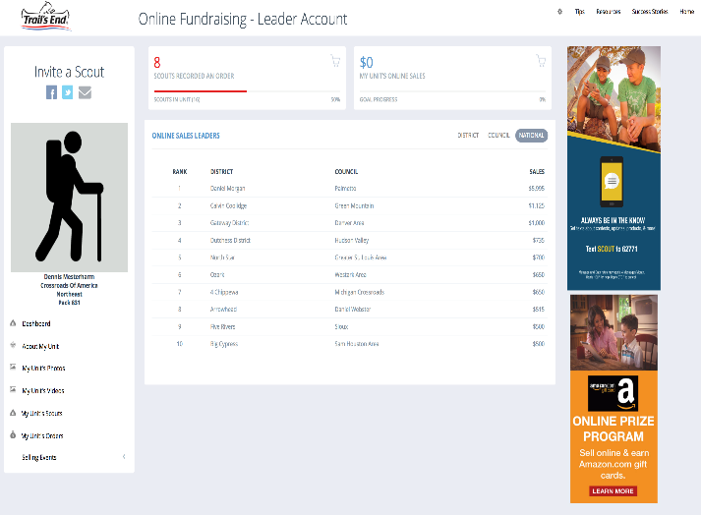
TRAILS-END.COM – LEADER
UNIT LEADER’S ACCT. DASHBOARD:
INVITE A SCOUT
UNIT SALES LEADERBOARD
UNIT ONLINE SALES PROGRESS GRAPHS
ACCOUNT NAVIGATION
2018 POPCORN FUNDRAISER

