Slide 1
Klondike
Winter Awareness Training

Slide 2
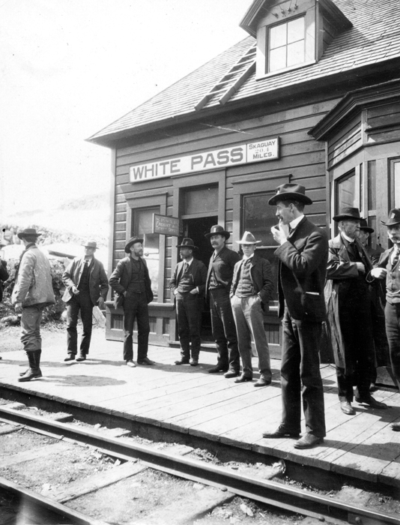

Slide 3
Training Agenda
Introduction
Preparing your unit for Klondike
Planning Steps
Training on How to Pack your Backpack
Preparing a hearty meal for your Patrol
Gear for cold weather camping
The Event: Friday Night - Sunday
Travel, Arrival, and Parking
Hitting the Trail
Checking in at Camp
Setting up Camp (Water, trash and Toilets)
Saturday Events - Town Mayor’s
Saturday Evening
Check out and the hike home

Slide 4
Preparing your Unit for Klondike
Planning Steps
Safety Considerations
Conditions change quickly
Buddy system, patrol method
Units stay together
Keeping warm means keeping dry (inside and out)
Emergency Action Plans
Leave No Trace
Tour Permits and Guide to Safe Scouting

Slide 5
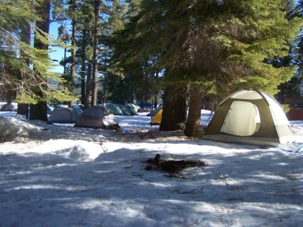

Slide 6
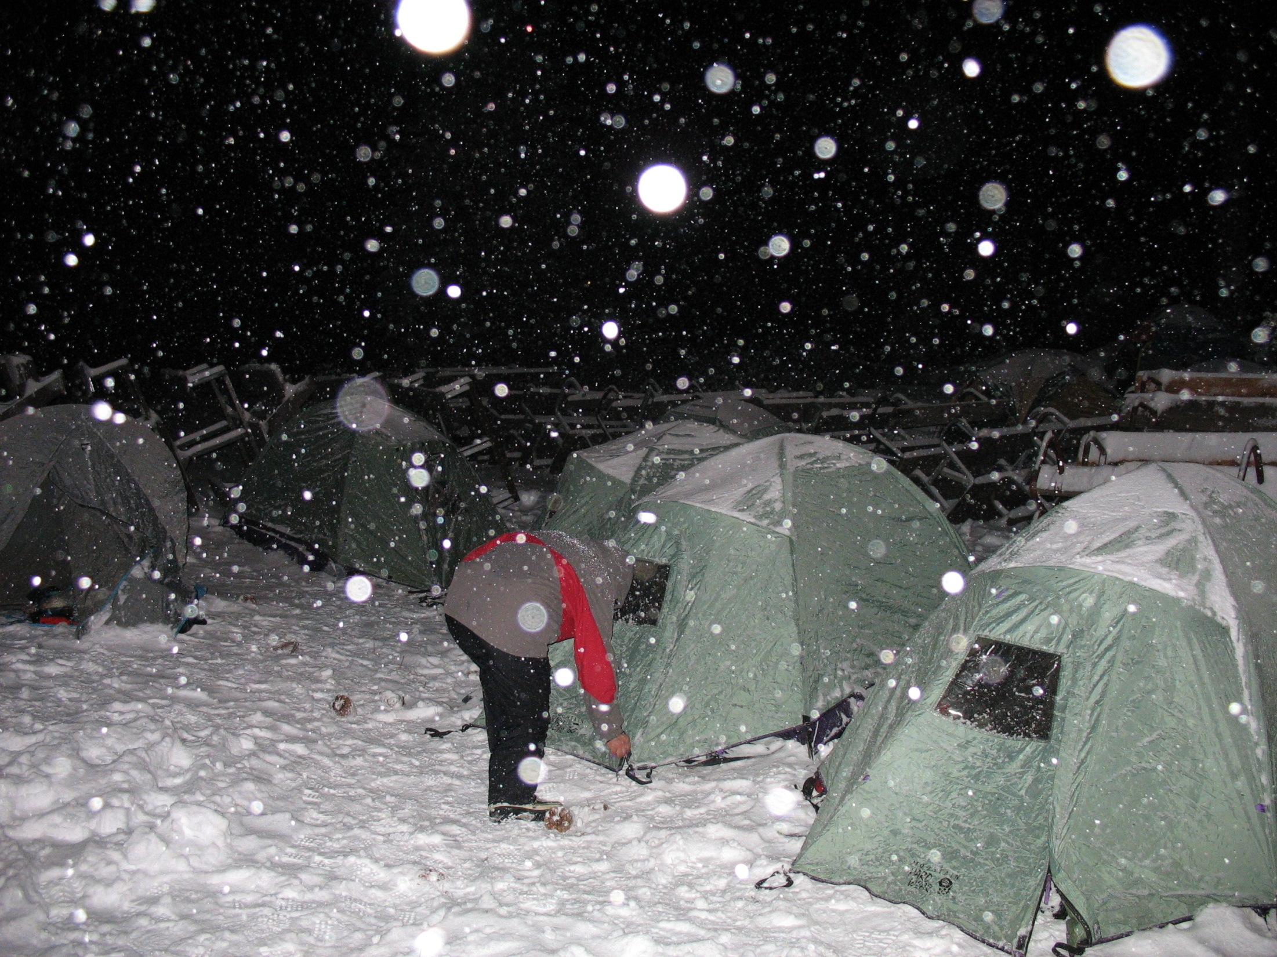

Slide 7
Be Prepared

Slide 8
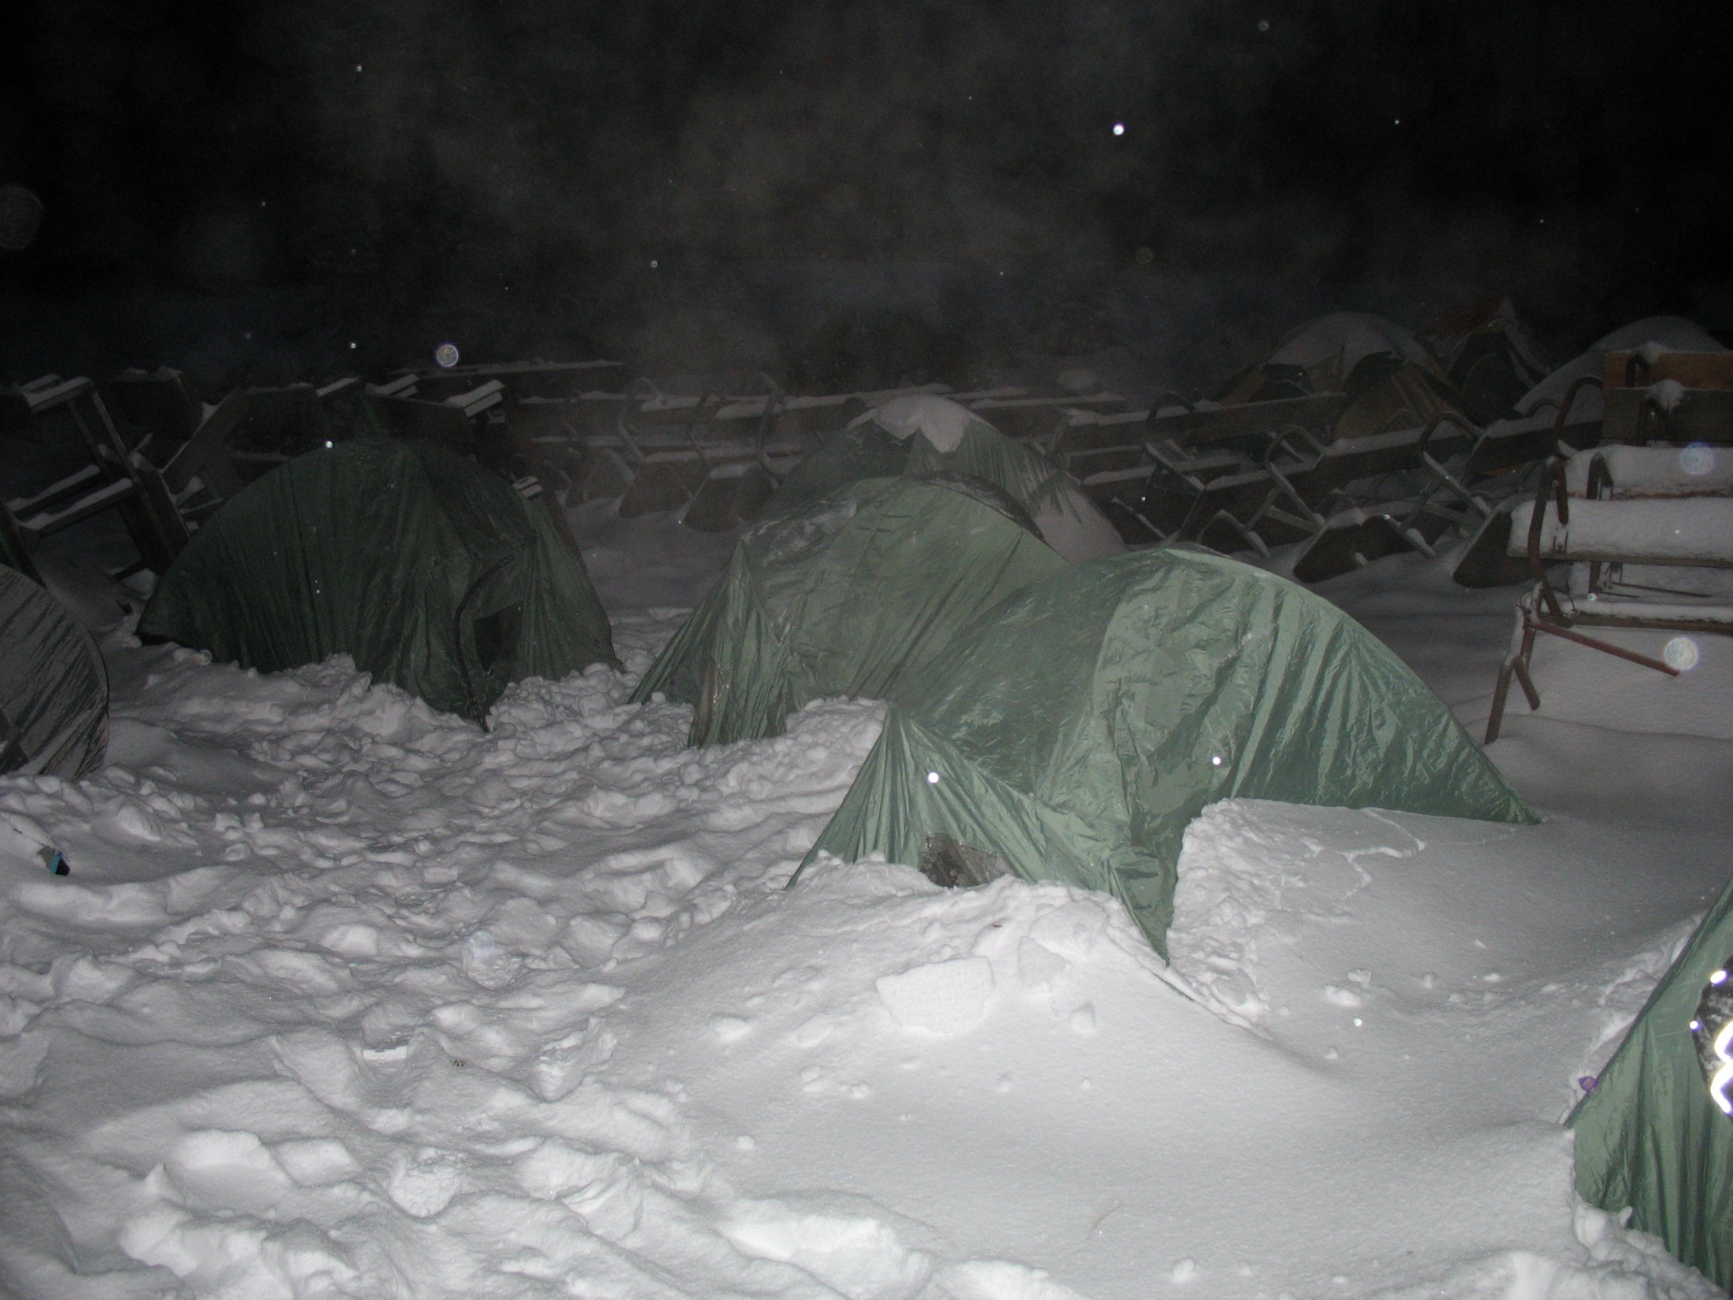

Slide 9
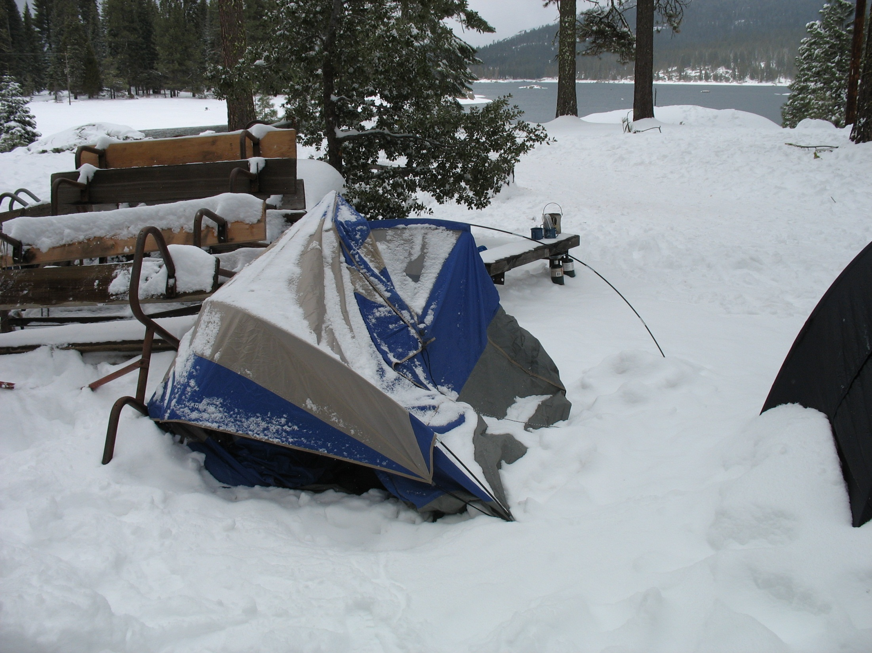

Slide 10
Packing your gear
Key points
Warm sleeping gear packed separate
Sleeping bag in waterproof bag
Carry only what you need
Use a checklist and double check
Use a meeting to inspect your packs and gear
Pack covers for poor weather

Slide 11
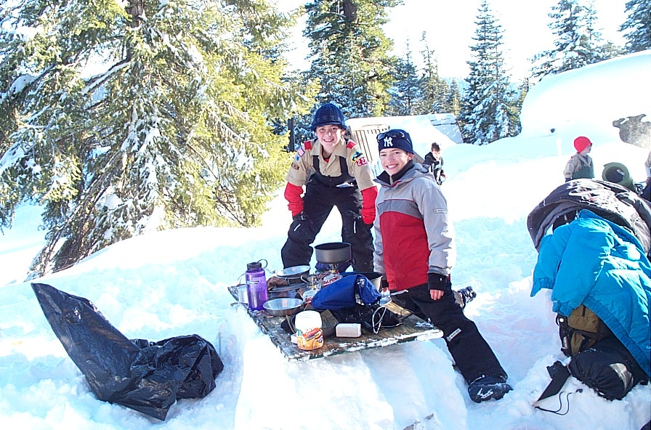

Slide 12
Feeding your Patrol
Key Points
Simple to prepare
One pot meal
High protein and high carbohydrates
Easy clean up
Tasty
Low cost
Plenty of liquids

Slide 13
Travel, Arrival, and Parking
Key Points
Check vehicles before you go
Driving conditions
Carry chains
Stop in Shaver Lake to put on gear
Be ready to unload when you arrive
Assemble your Unit clear of the unloading area

Slide 15
Training Agenda
Arrival
Unload at gate, take car to parking lot, hike in, check in on trail
Saturday Activities and Events -
Breakfast in Camp sites
Opening Ceremonies and Flags -
Events – Reports from the Town Mayor’s
Scoutmaster Tea -
Lunch time what you need to know–
Awards Ceremony –
Other Issues -
First Aid
Evacuation Plan, Poor Weather
Leave No Trace
Guide to Safe Scouting

Slide 16
Training Agenda
Introduction
Preparing your unit for Klondike
Planning Steps
Training on How to Pack your Backpack
The Event Begins – Friday Night
Travel, Arrival, and Parking
Hitting the Trail
Checking in at Camp
Setting up Camp (Water, trash and Toilets)
Preparing a hearty meal for your Patrol

Slide 17
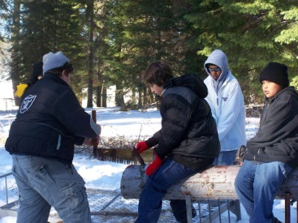

Slide 18
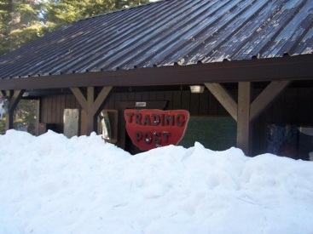

Slide 19
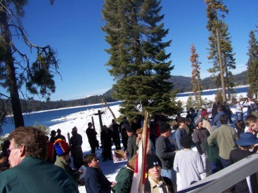

Slide 20
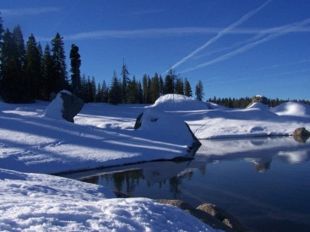

Slide 21
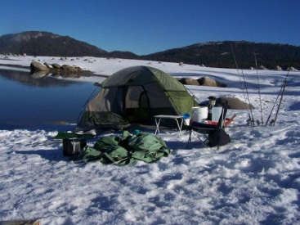

Slide 22
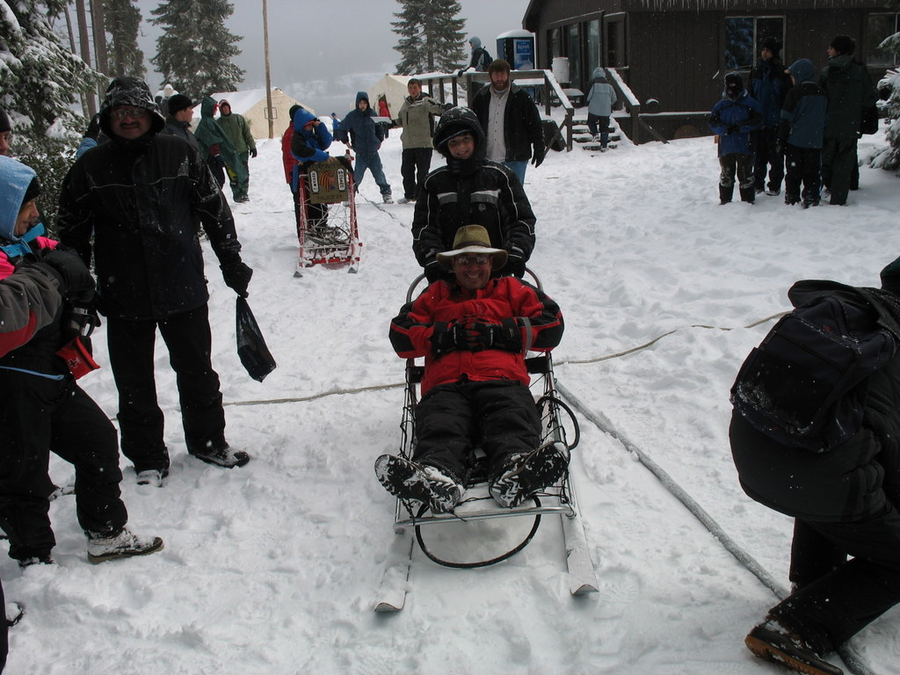

Slide 23
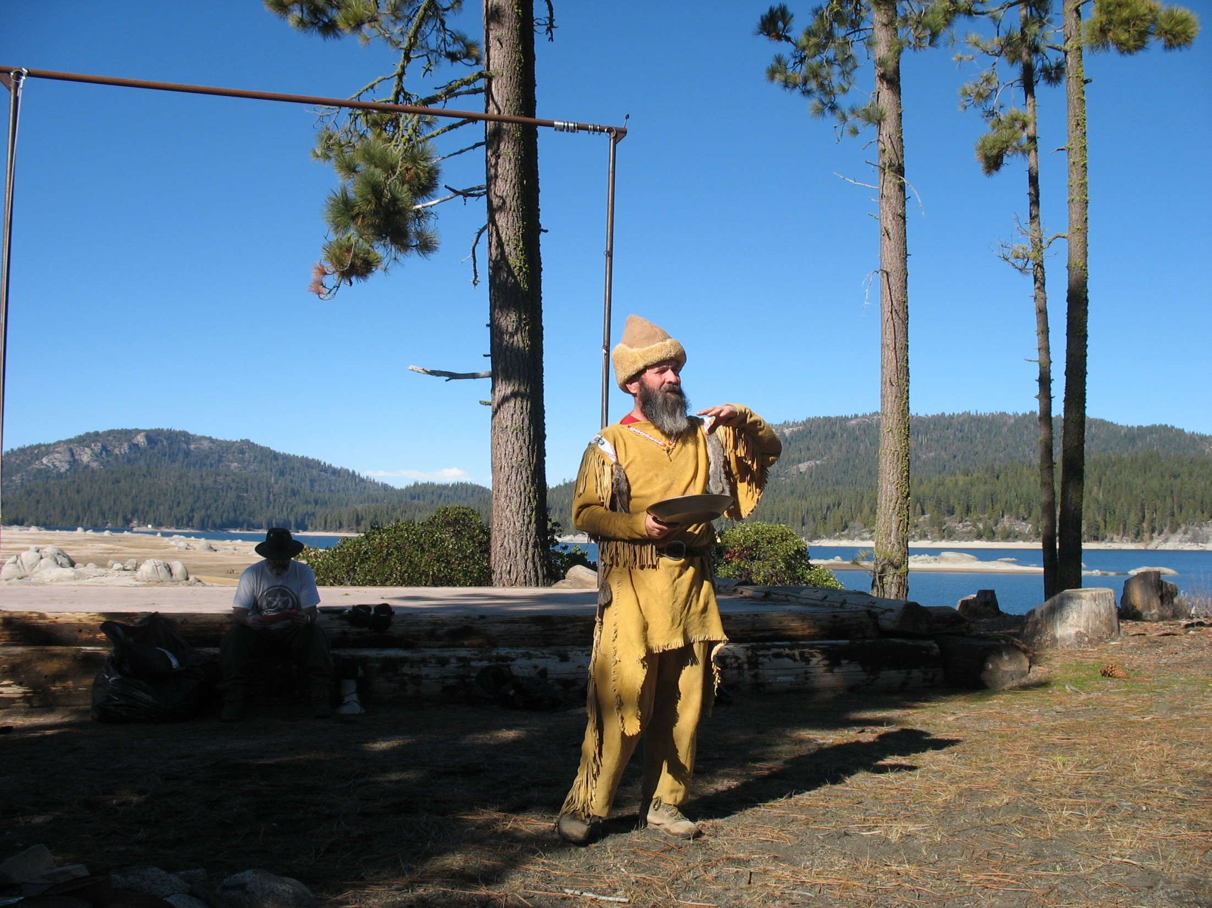

Slide 24
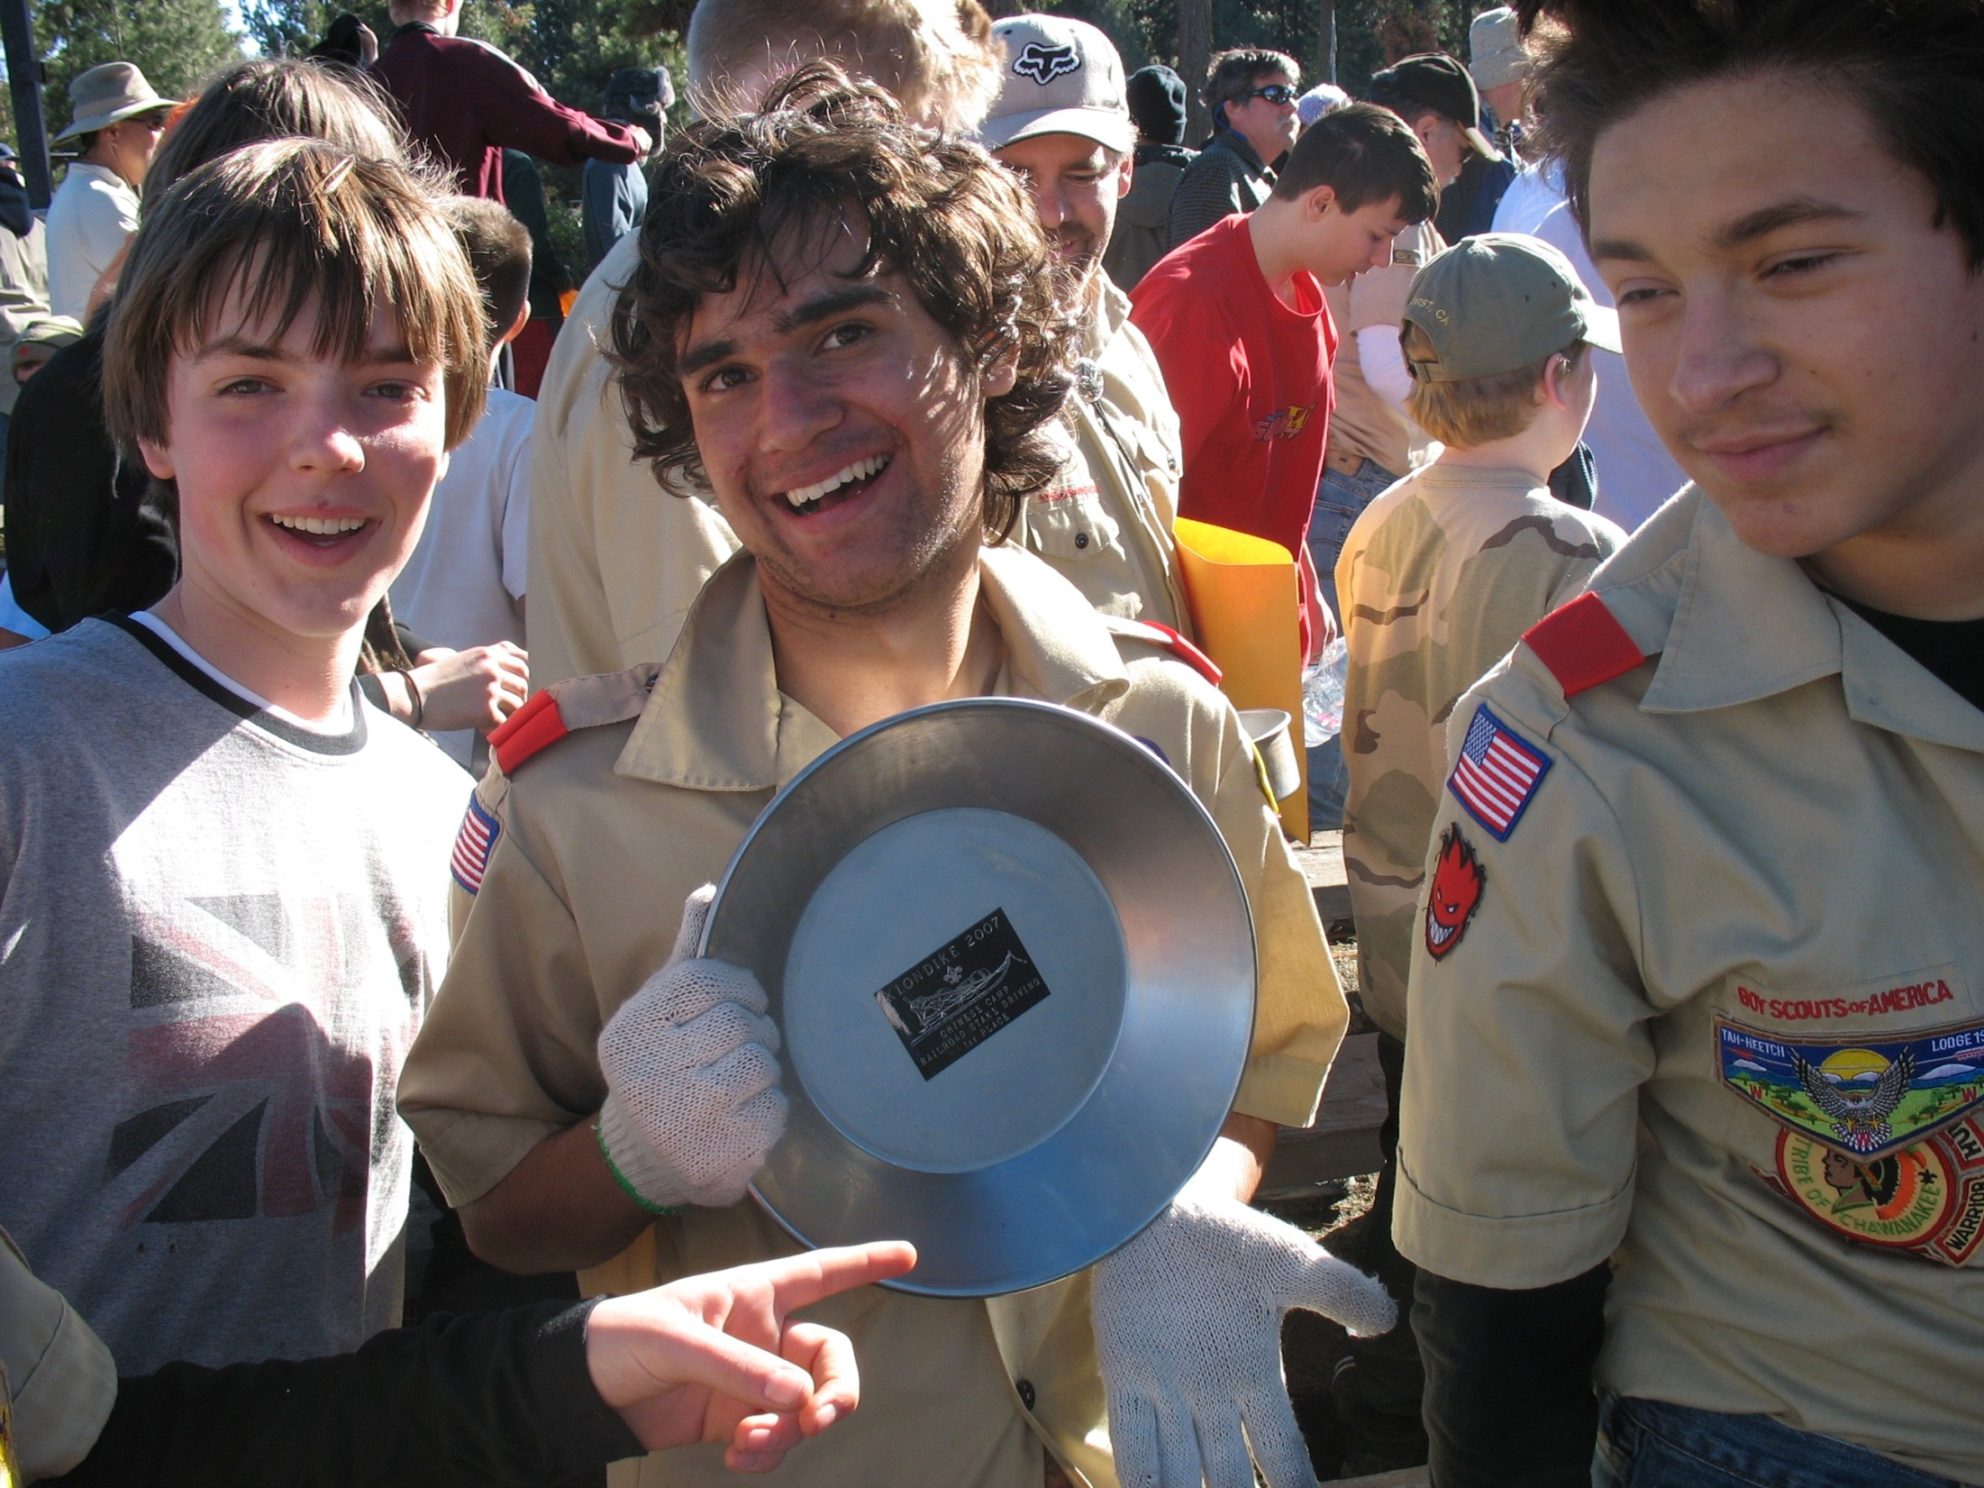

Slide 25
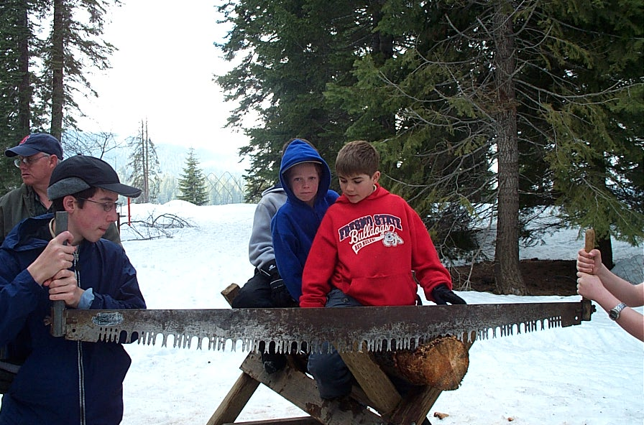

Slide 26
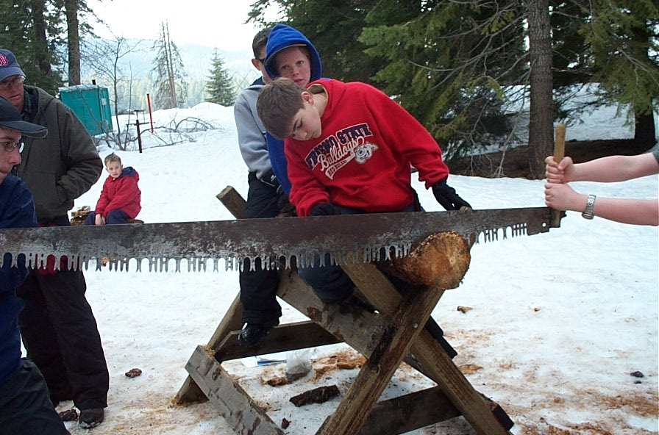

Slide 27
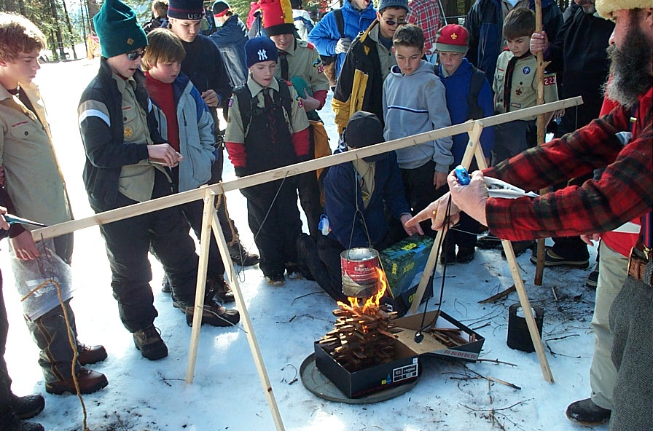

Slide 28
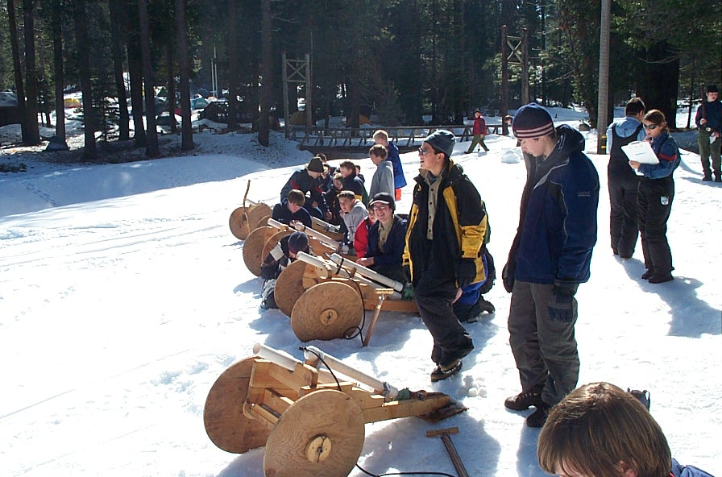

Slide 29
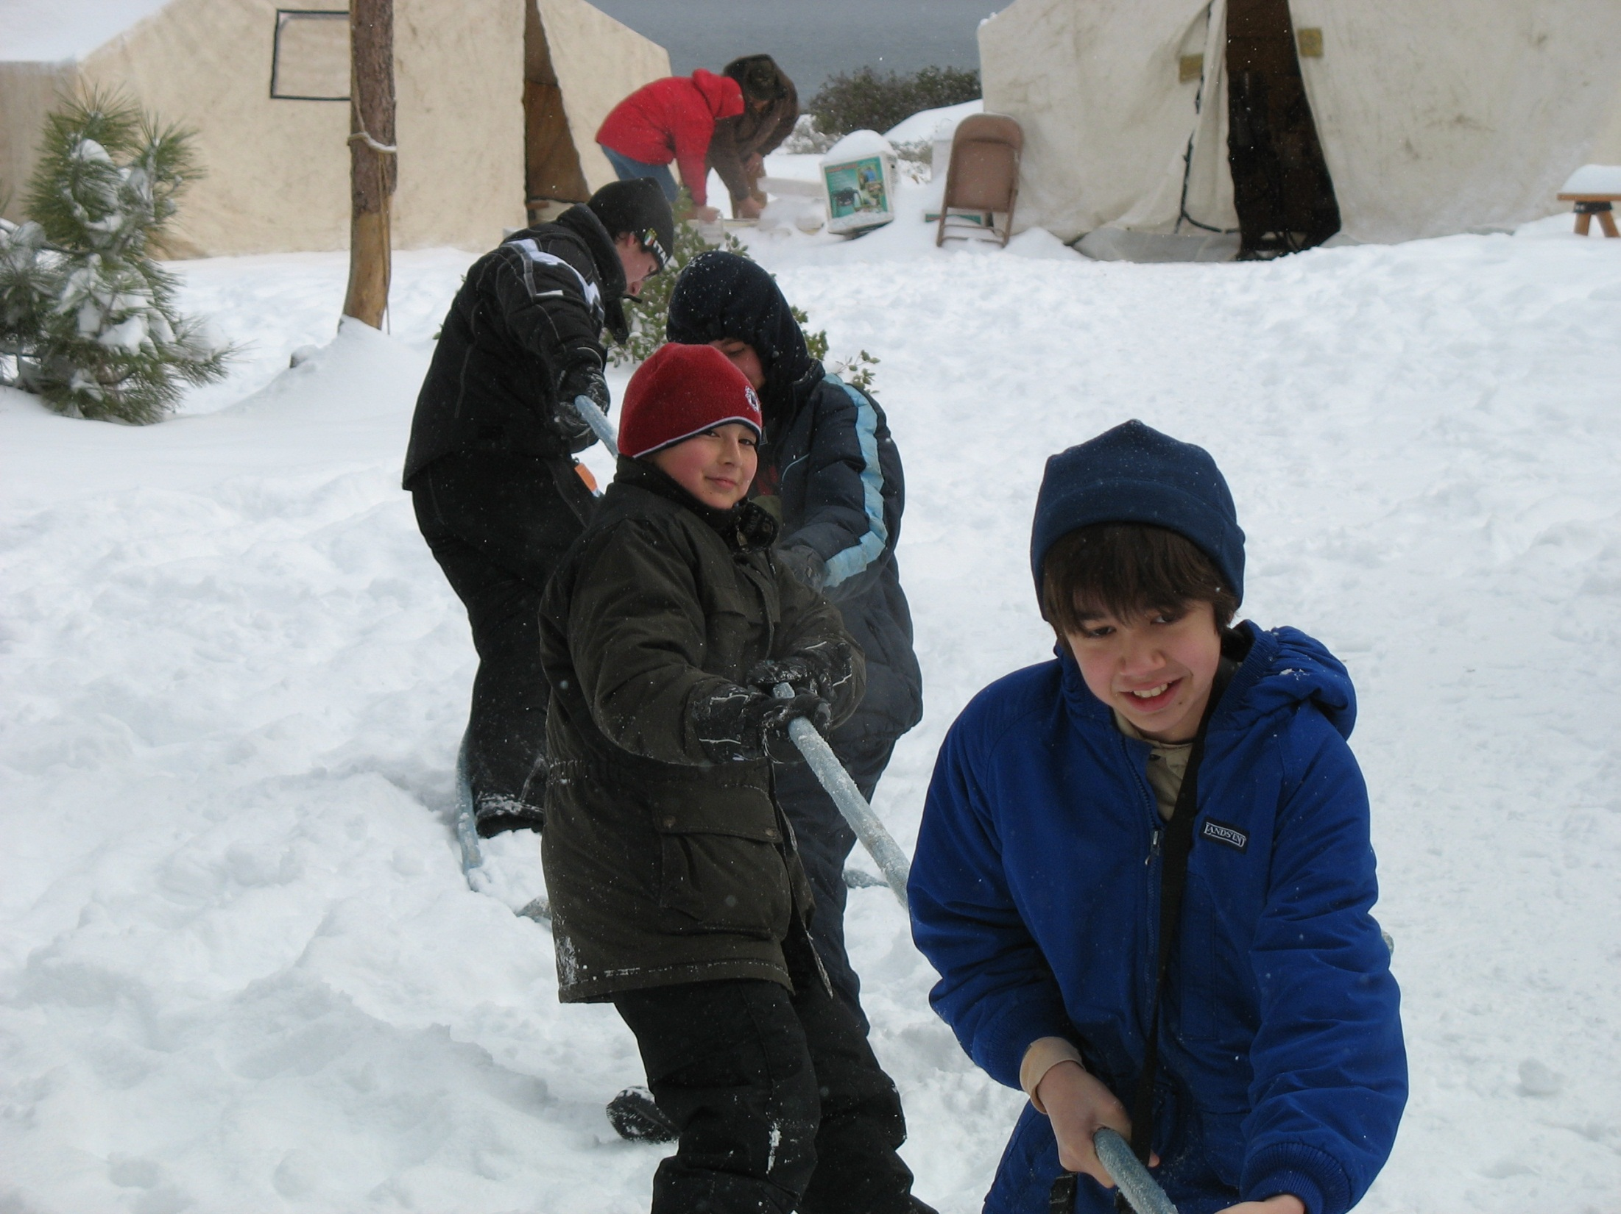

Slide 30
